Slide 1
Examining The Effect of Padding on Facial Recognition Using Convolution Neural Networks
Wycliffe Atswenje Sikolia
SCB384-3284/2013
Supervised By
Dr. Anthony Wanjoya
DR. Jane Aduda
MArch 26 2026

Slide 2
Outline
Methodology
Artificial neural networks
Convolution neural network architecture
Data Collection
Results and Discussion
Cycks Model
VGG Model
Comparison Between Cycks and VGG
Conclusion
Introduction
Background of the study
Statement of the Problem
Justification of the Study
Objectives of the Study
Literature Review
Facial recognition
Types of neural networks
Facial Recognition datasets
Facial recognition architectures

Slide 3
Background of The Study
The big data era is fueled by gadgets that emit and store huge amounts of data. Examples of such gadgets include the smartphones, laptops, desktops, and IOT devices such as smart watches, and smart refrigerators.
Huge technology companies such as Google and Apple have developed world class applications that have enabled them to enjoy a competitive advantage over other companies. These data science applications (from Google and Apple) have been made possible by techniques such as support vector machines, random forests, decision trees, and neural networks.
One field that emerged from deep learning is facial recognition. Lately, the field of facial recognition has attracted a lot of attention from scholars and practitioners. Some of the innovations that have emerged from facial recognition include development of home authentication systems, attendance management systems, security surveillance systems, and emotion recognition systems.
One of the techniques that is used for facial recognition is convolution neural networks, which relies on hyper parameters like pooling, padding, strides, kernels, and the activation function.
Examples of data sets that are used for facial recognition include the disguised faces in the wild, the VGGFace and the Komnet datasets.

Slide 4
Statement of The Problem
Researchers in facial recognition have developed solutions such as FaceNet, VGGFACE, VGG16, VGG19, OpenFace, and DeepFace. Even though existing solutions on facial recognition have been developed, the number of publications that investigate the effect of hyper parameter tuning on facial recognition are few.
Some of the authors that have examined how padding can affect the output neural network include Alrasheedi et al., (2023), Tang et al., (2019), and Reddy and Reddy (2019).
While the mentioned authors have touched on the effect of padding on neural networks, no study was found examining the effect of padding on convolution neural networks and facial recognition.
The most famous types of padding are valid and same padding. This begs the question: What would come out of examining the effect of padding on facial recognition? It is why this study aims to examine the effect of padding on facial recognition

Slide 5
Justification of The Study
The justification of this study relies on the fact that convolution neural networks is the one stop shop when developing solutions in computer vision. Here, the term computer vision is defined as a facet in deep learning that develops solutions by analyzing images or videos. One of the important hyper parameters used in convolution neural networks is padding
Padding is an important hyper parameter used in training convolution neural networks because of the value it adds in the performance of a convolution neural network.
Given the role padding plays in training convolution neural networks, it is important to examine how different padding methods contribute to the performance of a convolution neural network.
It would be prudent to tell how padding affects the accuracy and training time of a model. This will help practitioners and scholars when making decisions that rely on the accuracy and training time of facial recognition models.

Slide 6
Objectives
Main Objective
To examine the effect of padding on facial recognition using convolution neural networks and on the Komnet data set.
Specific Objectives
To build a facial recognition model using convolution neural networks
To examine the effect of padding on a modified pretrained model: VGGFACE-16.
To examine the effect of padding on facial recognition using a self-trained model
To compare the effect of padding on the modified VGGFACE-16 and a self-built model.

Slide 7
Literature Review
Facial recognition is a biometric technique used to identify faces and match those faces to a database of faces with an aim of identifying a human being from an image. From the definition, it is clear that face recognition is a two-step process with the first step being face detection and the second step being face identification.
The first step of facial recognition (or the face detection step) is identifying and extracting human faces from an image. In this step, all objects in an image are extracted and checked to confirm if a picture contains a human face. If any human face is present in the image, the face is extracted from the image before step two begins
In the second step or the image identification step, an image is compared to faces stored in a database to identify if the face matches the face of a known person.

Slide 8
Face Detection
Given an arbitrary image, the objective of facial detection is to establish whether or not there are any faces in the image and if present, return the image location and extent of each face.
There are several methods that could be used for detecting faces from images. These methods include knowledge based methods, feature invariant approaches, template matching methods, and appearance based methods.
Yang et al., (2002) list the following five challenges that are associated with facial detection: - pose, occlusion, aging face expression, imaging conditions and image orientation.

Slide 9
Challenges In Face Detection
Pose: A review of images databases will indicate that people like taking images in different poses. It follows that an image is likely to have a face that is twisted to the right, left, or even upside down.
Occlusion: Human beings often have features that could affect image detection. For instance, men are known to have beards, which may or may not exist in images.
Aging: Human faces are known to change with age progression which presents a challenge in facial recognition. This implies that there would be a significant difference in images if the time difference between the images is large.
Facial expressions: Images of human faces could also be affected by their emotions because people can change their faces based on emotions they are experiencing.
Imaging conditions and image orientation: A huge chunk of solutions in computer vision make the assumption that there is a single illuminant lighting in an image. Regardless, that is not always the case.

Slide 10
Face Detection Approaches
Knowledge Based Methods Of Facial Detection: This method relies on a set of rules to detect whether there is a human face in an image. The method captures the human knowledge of faces and interprets the knowledge into a set of rules. For instance, the face has two symmetric eyes; the eye areas are darker than the cheeks, the distance between eyes, and the difference in colors between the eyes and cheeks.
The Feature Invariant Approach of Face Detection: The feature invariant method of face detection is a little bit different from the knowledge based method because it uses statistical methods on facial landmarks. Examples of such landmarks include the eye corners, the nose tip, nostril corners, mouth corners, end points of eyebrow arcs, ear lobes, and the chin.
The Template Based Approach of Face Detection: The template based approach transforms an image into geometric primitives like curves and points. This is done by identifying distinctive features like the eye, the nose, the chin, and the mouth before measuring their relative positions.
The Appearance Based Approach of Facial Detection: The idea behind using Appearance methods for face detection relies on the linear algebra concept of subspaces. This approach of facial detection relies on the entire face, which is taken in as an input image data. The data collected from the input image is processed into a two dimensional pattern that is later used to decide whether there is a human face in an image.

Slide 11
Face Identification Approaches
Template Matching / Geometric Approaches: The template matching or the geometric approach of facial recognition is similar to the template matching of the face detection step. However, the objective of the facial recognition step is different from the objective in the face identification step. This owes to the reality that the objective of the facial recognition step is to match a face to a known person while the objective in the face detection step is to identify whether an object in an image is a human face or not.
Appearance Based Methods: Appearance based methods of face identification work the same way they work for face detection with the difference being the purpose of the method. This owes to the fact that the entire face is used to identify a face but with an aim of matching a face to that of a known person. Wu et al., (2018) also debate appearance based methods of facial recognition by examining facial expressions using the technique in question.

Slide 12
Types of Neural Networks
Multiple Layer Neural Network: A multilayer neural network consists of an input layer, which feeds in data to the first layer of the neural network. The first layer then feeds in data to at least one additional layer before sending the results to an output layer (for a case of a neural network with two layers).
Zhang et al., (2022) applied the artificial neural network algorithm on facial biological image information recognition and scanning. Specifically, the authors involved a methodology that used imaging technology to detect and extract the biological attributes of the image.
Balarini et al., (2011) assert that ANNs require a lot of time to train a model. The problem becomes even worse if the number of neurons and hidden layers required to train a model is high.
Another problem associated with ANNs is the vanishing gradient problem. Tarnate et al., (2020) define the vanishing gradient problem as a case when the neural network becomes too deep hence the network becomes hard to train and could result in a situation where network will not finish its training process.
Roza and Mohsen (2021) discuss some of the advantages of ANNS arguing that they have an extraordinary ability of in learning well in the face of minor disturbances.

Slide 13
Types of Neural Networks
Convolution Neural Networks: A Convolutional neural network (CNN) is a type of artificial neural network that has one or more convolution layers and are used mainly for image processing, classification, and segmentation. Consequently, CNNs use a convolution layer, a pooling layer, a fully connected layer and an activation function layer, which makes them different from ANNs. Koodalsamy, et al., (2023)
Xiaobo et al., (2023) recognize that facial recognition is hampered by factors such as posture, light and the background of the image. As a result, the authors proposed the addition of an attention mechanism to convolution neural networks in a bid to reduce the effects of factors that affect facial recognition.
Balarini et al., (2011) assert that ANNs require a lot of time to train a model. The problem becomes even worse if the number of neurons and hidden layers required to train a model is high.
CNNs bypass the feature engineering stage of deep learning because feature engineering in CNNs is done during the training time. Another advantage of convolutional neural networks is that they allow weight sharing, which in turn improves the efficiency of CNNs.
To begin with, convolution neural networks are known to perform poorly when used with negative images. Hosseini et al., (2017) defines negative images as those with reversed brightness, i.e., the lightest parts appear the darkest and the darkest parts appear lightest.

Slide 14
Padding in Convolution Neural Networks
Padding is one of the strategies used to develop convolution neural networks and often produces better results when used. What is padding? The term padding could be defined as a technique used in convolution neural networks where additional data is added to the edges of a dataset in order to prevent loss of information.
Zero Padding: This padding strategy has been used widely and occurs when zeros are added around an image at the expense of cropping or resizing an image.
Same Padding: This padding strategy is similar to zero padding when zeros are added to the edges of an image. However, a different figure, say 1, could be added on the edges of an image.
Valid Padding: valid padding occurs when no extra data is placed at the borders of a matrix or image. Essentially, it is best understood as the absence of padding.
Reflection Padding: This padding technique works by extracting pixels from the border of an image and adding them to the same border in reverse order.

Slide 15
Replication Padding: replication padding is almost similar to reflective padding only that rather than creating a reflection of the pixels around the edges of a matrix or image it duplicates adjacent values on the edges of the matrix or image. This padding strategy is also called mirror padding.
Circular Padding: Wraps the image values on one side around to the other side to provide the matrix with additional data that is required before a filter is applied. It is like data from the edges is extracted and placed in the opposite side of the matrix
Sequence Padding: is a type of padding strategy commonly applied to sequential or time series data. This padding technique is thoroughly documented by Rio et al., (2020) and can be divided into truncation padding, post-padding and pre-padding.
Reddy and Reddy (2019) investigated the effect of post-padding and pre-padding in Long short-term memory (LSTM) neural networks and CNNs.
Alrasheedi et al., (2023). The authors acknowledge that padding has been investigated shallowly. It is then, that they propose a padding technique that learns from shifts in hyper parameters of a CNN before adjusting padding effectively. Finally, Alrasheedi et al., (2023) introduce a padding module providing evidence that it performs better 1.49% and 0.44% more better in classification accuracy than the zero padding

Slide 16
Facial Recognition Datasets
An array of studies have been conducted on facial recognition implying that there exist several datasets that could be used for facial recognition. Ayad et al., (2023) conducted a study discussing twenty-one different datasets that have been used for research in facial recognition.
Disguised Faces in The Wild Dataset: The disguised faces in the wild dataset contains 11,157 images collected from 1,000 different people. This data set was collected from the internet and was released in 2018 during the Disguised Faces in the Wild Workshop at International Conference on Computer Vision and Pattern Recognition.
VGGFACE: VGG Face dataset is made up of 2.6 million images collected from 2,622 different people. This dataset comprises mostly of politicians, actors, public figures and celebrities, which was made by extracting male’s and females’ information from the Internet Movie Database and ranked by popularity.
KomNET Face Dataset: The KomNET face dataset comprises of 39,600 images but the number of people whose faces were collected from is not stated in the publication associated with the dataset

Slide 17
Facial Recognition Architectures
The term architecture here refers to a deep learning model that could be used to match or a recognize a face belonging to a particular person. An example of an author that has conducted review on facial recognition architectures is sun and Redei (2022).
Google FaceNet: Popularly known as FaceNet, is a facial recognition architecture that was developed by researchers at Google. This architecture relies on an earlier architecture called Inception Network, which generates convolution and concatenates the revolutions to improve the efficiency of the architecture.
DeepFace: Meta published the results from the study that produced DeepFace. It is important to note that the researchers introduced an idea of 3D modelling based on face fiducial points, which in turn is used to align faces.
VGGFACE-16: VGGFACE-16 is a facial recognition that was developed by Karen Simonyan and Andrew Zisserman from the University of Oxford (Koo et al., 2018). It comprises multiple sequential connected layers with each layer receiving output from the previous layer. Specifically, it is made up of 16 layers where the first thirteen layers are convolution layers while the last three layers are fully connected layers.

Slide 18
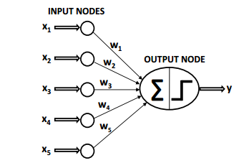
Methodology
Artificial neural networks is a machine learning technique that tries to imitate the intelligence of a human brain. The human brain contains neurons that are connected to one another through axons and dendrites. The connecting region between axons and dendrites is called a synapse.
Like biological neurons, artificial neural networks contain computational units called neurons. These computational units are connected to one another through weights that perform the same role as synapses in biological neurons.
Consider the image shown in figure 1 and the case of a binary response variable (Y) with 1 is the presence of an observed parameter and 0 the absence of the observed parameter. The input layer contains predictor variables (X₁, X₂, …, X_{n}) with weights (W₁, W₂, …, W_{n}), which are mapped to the output node Y using an activation function
Figure 1

Slide 19
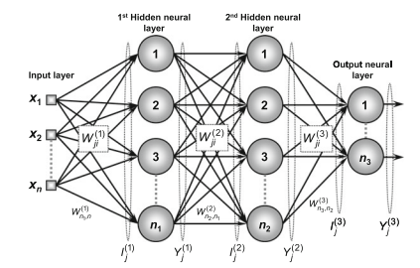
Deriving the Backpropagation Algorithm
Let W L ji be the weight matrices denoting the value of the synaptic weight that connects the jth neuron of layer (L) to the ith neuron of layer (L - 1). Consider the image in figure alongside.
1. W (3) ji is the synaptic weight connecting the jth neuron of the output layer to the ith neuron of layer 2.
2. W (2) ji is the synaptic weight connecting the jth neuron of hidden layer 2 to the ith neuron of layer 1.
3. W(1) ji is the synaptic weight connecting the jth neuron of hidden layer 1 to the ith signal of the input layer.
Figure 2

Slide 20
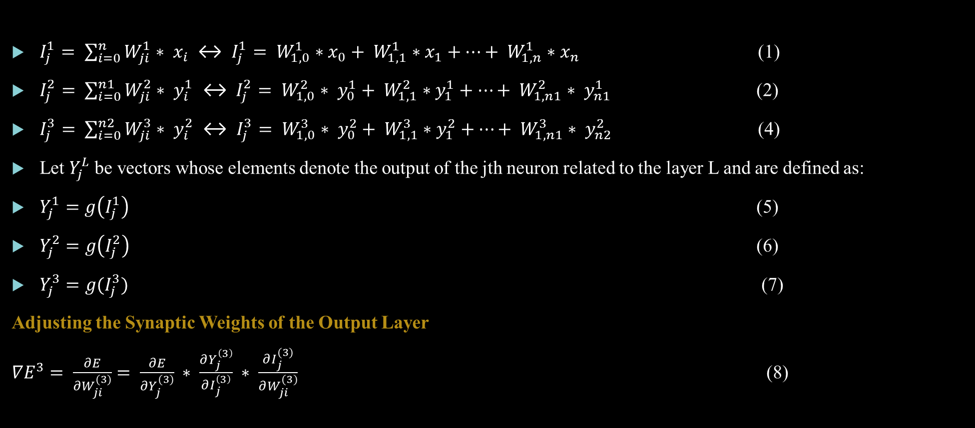
$I_{j}^{1}= \sum_{i=0}^{n}{W_{ji}^{1}∗ x_{i} ↔ I_{j}^{1}}= W_{1,0}^{1}∗x_{0}+ W_{1,1}^{1}∗x_{1}+…+ W_{1,n}^{1}∗x_{n}$ (1)
$I_{j}^{2}= \sum_{i=0}^{n1}{W_{ji}^{2}∗ y_{i}^{1} ↔ I_{j}^{2}}= W_{1,0}^{2}∗ y_{0}^{1}+ W_{1,1}^{2}∗y_{1}^{1}+…+ W_{1,n1}^{2}∗ y_{n1}^{1}$ (2)
$I_{j}^{3}= \sum_{i=0}^{n2}{W_{ji}^{3}∗ y_{i}^{2} ↔ I_{j}^{3}}= W_{1,0}^{3}∗ y_{0}^{2}+ W_{1,1}^{3}∗y_{1}^{2}+…+ W_{1,n1}^{3}∗ y_{n2}^{2}$ (4)
Let $Y_{j}^{L}$ be vectors whose elements denote the output of the jth neuron related to the layer L and are defined as:
$Y_{j}^{1}=g\left(I_{j}^{1}\right)$ (5)
$Y_{j}^{2}=g\left(I_{j}^{2}\right)$ (6)
$Y_{j}^{3}=g(I_{j}^{3})$ (7)
Adjusting the Synaptic Weights of the Output Layer
$∇E^{3}= \frac{∂E}{{∂W}_{ji}^{(3)}}= \frac{∂E}{{∂Y}_{j}^{(3)}} ∗ \frac{∂Y_{j}^{\left(3\right)}}{∂I_{j}^{\left(3\right)}} ∗ \frac{∂I_{j}^{(3)}}{∂W_{ji}^{(3)}}$ (8)

Slide 21

$\frac{∂I_{j}^{(3)}}{∂W_{ji}^{(3)}}=Y_{i}^{\left(2\right)}$ (Obtained from the partial derivative of equation 4 with respect to $W_{ji}$) (9)
$\frac{∂Y_{j}^{(3)}}{∂I_{j}^{(3)}}= g^{′}\left(I_{j}^{\left(3\right)}\right)$ (Obtained from equation 7) (10)
$\frac{∂E}{∂Y_{j}^{(3)}}= −\left(d_{j}− Y_{j}^{\left(3\right)}\right)$ (Obtained from equation 8) (11)
$\frac{∂E}{∂W_{ji}^{(3)}}= −\left(d_{j}− Y_{j}^{(3)}\right)∗g^{′}\left(I_{j}^{(3)}\right)∗Y_{i}^{(2)}$ (12)
Let $δ_{j}^{3}= −\left(d_{j}− Y_{j}^{(3)}\right)∗g^{′}\left(I_{j}^{(3)}\right)$ and $ŋ$ be the learning rate. (13)
Also, note that the direction of the weight $W_{ji}^{(3)}$ matrix must be made in the opposite direction of the gradient because the optimization goal is to minimize the squared error (Da Silva et al., 2017).

Slide 22

$∆W_{ji}^{\left(3\right)}= −ŋ ∗ \frac{∂E}{∂W_{ji}^{\left(3\right)}}$ $↔$ $∆W_{ji}^{\left(3\right)}=ŋ ∗ δ_{j}^{\left(3\right)}∗ Y_{i}^{\left(2\right)}$ (14)
Equation 14 can also be written as $W_{ji}^{current}= W_{ji}^{previous}+ ŋ ∗ δ_{j}^{\left(3\right)}∗ Y_{i}^{(2)}$
In short, we have shown through equation 14 that the neuron adjusts weights of the output layer by considering the difference the observed values and the actual values.
The same can be shown for weights in the intermediate layers

Slide 23
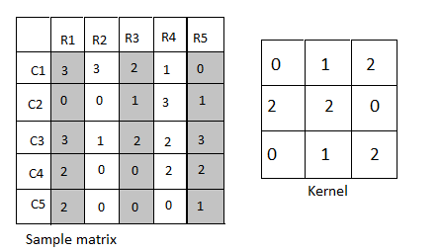
Convolution Neural Network Architecture
Convolution neural networks rely on their architecture to make predictions from inputs. This architecture can be divided into feature extraction and model prediction. The feature extraction phase relies on techniques such as filtering, the stride, padding, pooling and flattening. In order to explain how each of these techniques contributes to the architecture of the neural network we shall rely on the image shown in figure 3 alongside
Figure 3

Slide 24
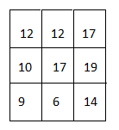
Filtering in Convolution Neural Networks
The kernel in figure 3 above slides from R1 to row R3 and from column C1 to column C3 and multiplies the resulting matrix with the kernel. In this case, the result of the dot multiplication is 12. It then slides over and beginning form row R2 to row R4 and column C1 to column C3. The result of this dot multiplication is also 12. The last filter happens from row R3 to row R5 and column C1 to column C3. The result from this dot multiplication is 17.
The kernel then moves one column downwards and takes a 3 by 3 matrix from row R1 column C2 to row R3 column C4 and multiplies itself with this matrix to give 10. Holding the same columns, the kernel slides from row R2 to row R4 and multiplies the resulting matrix with itself to give 17.
It then slides from row R3 to R5 and multiplies the resulting matrix with itself to give 19. The procedure is through rows R1 to R5 and columns C3 to C5 to give 9, 6 and 14 as the results. The results are combined into what is called the feature map and is shown in the figure 4 alongside
Figure 4

Slide 25
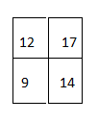
Strides in Convolution Neural Network
A stride in convolution neural networks could be defined as a step used by the filter(kernel) to slide over the input image. A stride of 1 means that the filter moves one pixel at a time, while a stride of 2 means it moves two pixels at a time.
Let us take the sample matrix and kernel in figure 3 above into consideration (assuming that we have a stride of 1) and use it to explain how strides are used in convolution neural networks.
The filter will begin in the same position as the filtering process i.e. from R1 to row R3 and from column C1 to column C3 and multiplies the resulting matrix with the kernel.
In this case, the result of the dot multiplication is 12. It will then move one pixel to the right and begin filtering from row R3 to row R5 and column C1 to column C3. The result from this dot multiplication is 17.
Moving downwards the stride will skip one pixel downwards and begin the filtering process from column C3 to column C5 to give 9 as the result. It will then skip one row and begin filtering from row R3 column C3 which will give 14 as the result.
In short, the matrix and kernel in figure 4 and a stride of 1 will produce a feature map shown in figure 5 alongside.
Figure 5

Slide 26
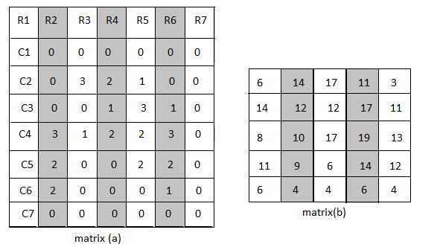
Padding in Convolution Neural Networks
It is important to demonstrate how padding: -specifically zero padding, is used in convolution neural networks. This owes to the fact that the paper will create a facial recognition model with zero padding and no padding in order to investigate the effect of padding in facial recognition.
Zero padding in CNNs is achieved by adding zeros around an input image before filtering is applied to the resulting matrix in order to create a feature map. Consider the sample matrix in the figure 3 above, adding zeros around the matrix produces the matrix (a) in figure 6 alongside.
The matrix (a) in figure 6 alongside is then subjected to a filter using the kernel in figure 4 to produce the matrix(b) in figure 3.6 alongside.
It is important to note that the dimension of the matrix(b) in figure 6 below is equal to the dimension of the sample matrix in figure 3 above.
Figure 6

Slide 27
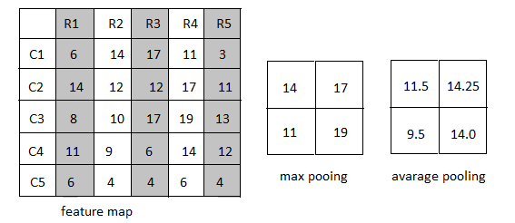
Pooling in Convolution Neural Networks
Pooling is a technique used to reduce a feature map into a much smaller dimension while maintaining critical features from a feature map. There are two main pooling techniques - max pooling and average pooling.
Max pooling divides the feature map into 2 by 2 matrices and selects the maximum value from each of the divided matrices before combining the result into a matrix.
In contrast, rather than take the maximum value from each matrix it finds the averages and concatenates the results as shown in the matrix called average pooling in figure 7 alongside.
Figure 7

Slide 28

Batch Normalization
Batch normalization is used by neural networks to improve the speed and stability of the training process. Critical to the discussion is the fact that Sergey and Szegedy (2015) have a publication on some of the benefits of batch normalization.
This owes to the fact that batch normalization does not only improve the speed and the stability of the training process, but also reduces the internal covariate shift. The term internal covariate shift could be defined as a phenomenon where the distribution of outputs of a neural network change when the model is still being updated.
That said, this technique occurs by adjusting the values in each variable using the mean, standard deviation, scaling parameter, and a bias. This is done using equation 15 below. It is important to highlight that the scaling parameter and the bias, like the weights of a neural network, are adjusted in order to minimize the loss function.
$y_{i}= γ\hat{x_{i}}+β$ where 15
$\hat{x_{i}}= \frac{x_{i }− μ_{β}}{\sqrt{δ_{β}^{2}}+ε}$ 16

Slide 29
Data Collection
Data collection is crucial step in this study because the researcher is going to rely in images collected from study participants.
While collecting data for facial recognition would be interesting, it is a time consuming and difficult process because study participants would be reluctant to share images of their faces.
It is notable that data sets such as the disguised faces in the wild, the VGGFace and the Komnet datasets could be used for the study.
The Komnet dataset was chosen for the study because Astawa et al., 2020, the authors of the data set give users permission to use and even improve the dataset. Moreso, the size of the data set is small enough, which allows the researcher to conduct the experiment at a minimal cost.

Slide 30
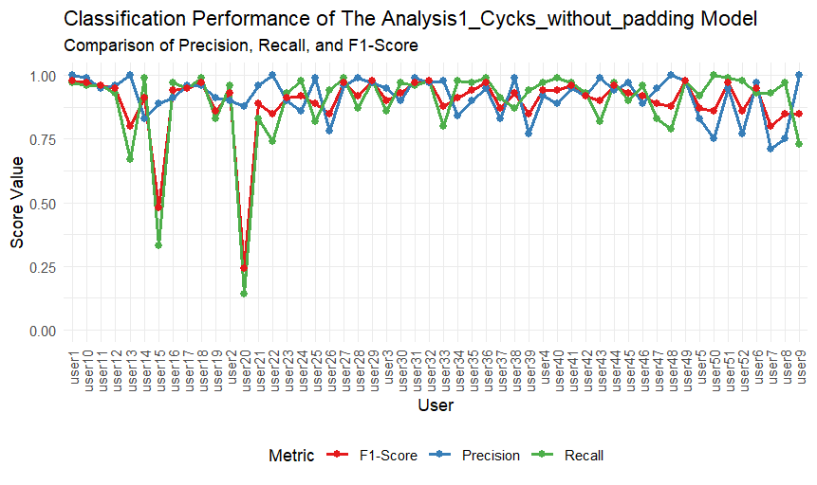
Results and Discussion
The researcher conducted the experiment several times just to ascertain the accuracy and quality of the results collected for the experiment.
For example, the author was able to establish that some of the users in the dataset did not have enough images to produce quality results and were excluded from the experiment.
Figure 8

Slide 31
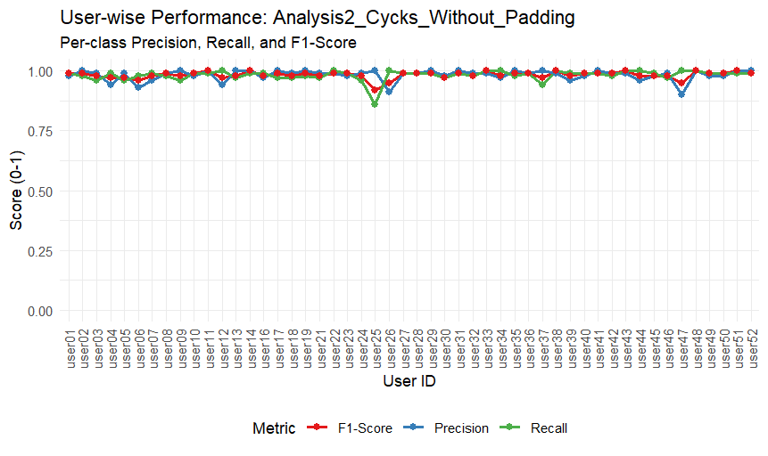
As you can see from figure 8 above user 15 and user 20 recorded very low scores in precision, recall, and F-Score. It is because the users had very few images compared to other users. Data from user 15 and user 20 were excluded from the analysis.
As you can see from figure 9 below the performance of the model called Cycks without padding improved after dropping images from the two users.
Figure 9

Slide 32
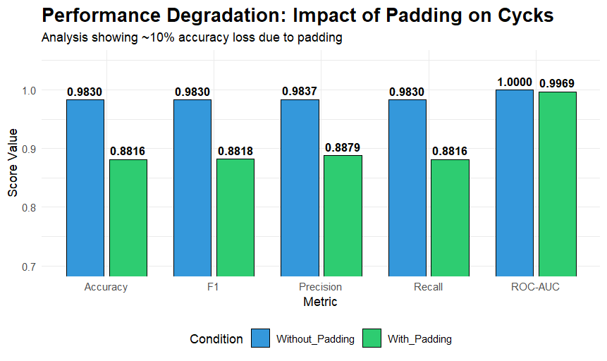
The researcher was able to build two models called cycks with padding and cycks without padding. The cycks with padding model was built with padding while the cycks without padding was built without padding.
Figure 10

Slide 33
Effect of Padding on the Cycks Model
Results from figure 10 indicate that padding does not improve model performance. Instead, the absence of it improves model performance.
All performance metrics increased on the cycks model without padding.

Slide 34
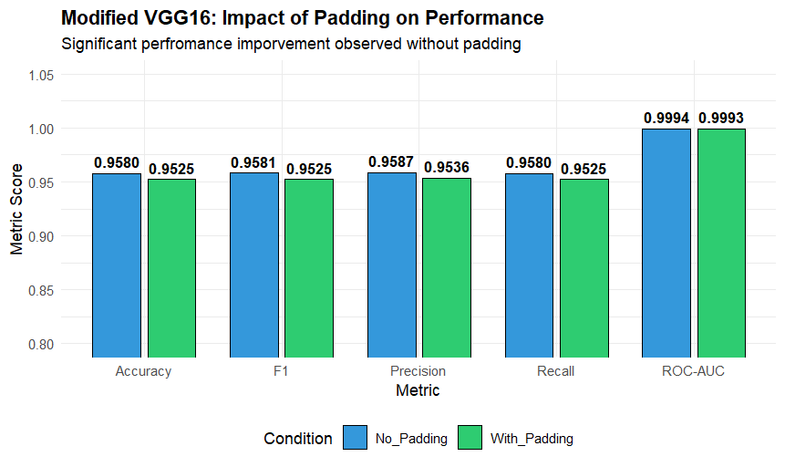
The Effect of Padding on The Modified VGG Model
We call it the modified VGG model because the actual VGG 16 model has sixteen layers while the model used in the experiment has 11 layers. The reason being sixteen layers cannot support a model with padding.
Figure 11

Slide 35
The Effect of Padding on The Modified VGG Model
The performance metrics of the modified vgg model was almost similar in both cases. i.e. the model with padding and the model without padding.
However, the model without padding performs better than the model with padding by few decimal points on all the metrics. Refer to figure 4.4 for comparison.
Reddy et al. (2019) highlight that while padding is a standard preprocessing step, it has a measurable impact on performance. The authors demonstrate that padding acts as noise in the feature extraction process, which can lead to a drop in classification accuracy.
In the paper Mind the pad – CNNs can develop blind spots, Alsallakh et al. (2021) introduce the idea of spatial bias and "blind spots." They prove that zero-padding creates "line artifacts" and "foveation" (where the model becomes biased toward the center and ignores the edges). They show that this bias can be detrimental to tasks requiring high precision at the boundaries.

Slide 36
Conclusion
The results from this study show that padding has detrimental effects on the overall performance of CNNs on facial recognition tasks.
Alsallakh et al. (2021) and Reddy et al. (2019) have already brought up this argument.
Considering that padding has recorded reduced performance in both the cycks model and the modified VGG model, the study agrees with Alsallakh et al. (2021) and Reddy et al. (2019).
However, it is common knowledge in the field that padding improves the performance of CNNs on object recognition tasks.
This calls for further research. Perhaps padding is only required on the initial layers or later layers of a convolution neural network to avoid what Alsallakh et al. (2021) call the spatial bias.
Indeed, hyper parameter tuning could have an effect the performance of convolution neural networks. Thus, examining how hyperparameters like batch normalization, strides, pooling,

Slide 37
References
Alrasheedi, F., Zhong, X., & Huang, P.C. (2023). Padding Module: Learning the Padding in Deep Neural Networks. IEEE Access, 11, 7348-7357.
Alsallakh, B., Kokhlikyan, N., Miglani, V., Shu, J., & Reblitz-Richardson, O. (2021). Mind the pad – CNNs can develop blind spots. International Conference on Learning Representations (ICLR). https://openreview.net/forum?id=u7v_62q6DpI
Astawa, I. N. G. A., Putra, I. K. G. D., Sudarma, M., and Hartati, R. S. (2020). KomNET: Face Image Dataset from Various Media for Face Recognition. Data in Brief, 31(105677): 1-5.
Balarini, P. J., Nesmanchnow, S., Rodriguez, M. (2011). Facial Recognition Using Neural Networks over GPGPU. CLEI Electronic Journal, 13(3): 1-12.
Hosseini, H., Xiao, B., Jaiswal, M., and Poovendran R. (2017). On the Limitation of Convolutional Neural Networks in Recognizing Negative Images. Retrieved from: https://arxiv.org/pdf/1703.06857.pdf. Retrieved on: 9 September, 2024.
Koodalsamy, B., Bairavan, V., Narayanasamy, V. (2023). Face Recognition using Deep Learning. International Conference on Smart Engineering for Renewable Energy Technologies (n.p.). Rajapalayam, India. https://doi.org/10.1051/e3sconf/202338705001. Retrieved on: 29 October, 2023
Reddy, M. D., & Reddy, S. N. (2019). Effects of Padding on LSTMS and CNNS. Retrieved from: https://arxiv.org/abs/1903.07288. Retrieved on: 28 August, 2024.
Roza, D., and Mohsen S. (2021). Artificial Neural Network Systems. International Journal of Imaging and Robotics, 21(2):13-25.

Slide 38
Selected References
Tang, H., Ortis, A., & Battiato, S. (2019). The Impact of Padding on Image Classification by Using Pre-trained Convolutional Neural Networks. In E. Ricci, S. Rota Bulò, C. Snoek, O. Lanz, S. Messelodi, & N. Sebe (Eds.), Image Analysis and Processing -- ICIAP 2019 (pp. 337–344). Cham: Springer International Publishing.
Tarnate, J. M., Devaraj, M., and Goma, C, J. (2020). Overcoming the Vanishing Gradient Problem of Recurrent Neural Networks in The Iso 9001 Quality Management Audit Reports Classification. International Journal of Scientific and Technology Research, 9(3): 6683- 6686.
Xiaobo, Q., Chenxu, W., Ying, S., Hui, Q., Kaige, D., and Xiaobin, W. (2023). A Convolutional Neural Network Face Recognition Method Based on BiLSTM and Attention Mechanism. Computational Intelligence and Neuroscience, 2023(2501022): 1-14.
Zhang, Z., Hu, R., and Hu, W. (2022). Application of Artificial Neural Network Algorithm in Facial Biological Image Information Scanning and Recognition. Contrast Media & Molecular Imaging, 2022(1142682): n.p.

Slide 39
Thank You

